Slide 1
Bank Marketing Effectiveness Prediction
by
Saikat Kar

Slide 2
INDEX
Introduction
Defining Problem Statement
Description of the variables
Exploratory data analysis (Multivariate)
Feature Selection
Model building (Encoding, Class Imbalance treatment)
Metric determination(performance of models)
Comparison of algorithms

Slide 3
Introduction
Bank marketing is the design structure, layout and delivery of customer-needed services worked out by checking out the corporate objectives of the bank and environmental constraints.
A term-deposit is a fixed term investment that includes the deposit of money into an account at a financial institution.
Term-deposit investments usually carry short term maturities ranging from one month to few years and will have varying levels of required minimum deposits.
The investor must understand when buying a term-deposit that they can withdraw their funds only after the term ends. In some cases, the account holder may allow the investor early termination-or withdrawal-if they give several days notification. Also, there will be a penalty assessed for early termination.

Slide 4
Problem Statement
The data is related with direct marketing campaigns (phone calls) of a Portuguese banking institution. The marketing campaigns were based on phone calls . Often, more than one contact to the same client was required, in order to access if the product (bank term deposit) would be (‘yes’) or not (‘no’) subscribed. The classification goal is to predict if the client will subscribe a term deposit (variable y)

Slide 5
Description of variables
Variable | Description | Type
y | Indicates whether client has subscribed to a term deposit | Categorical
age | Age of the client | Numeric
job | Job of the client | Categorical
marital | Marital status of the client | Categorical
education | Education of the client | Categorical
default | Indicates whether client has credit in default | Categorical
housing | Indicates whether client has a housing loan | Categorical
loan | Indicates whether client has a personal loan | Categorical
contact | Type of call contact communication | Categorical
month | Month of call | Categorical
day of week | Day of call | Categorical
duration | Duration of call in seconds | Numeric
campaign | Number of contacts made during current campaign for this client | Numeric
pdays | Days since last contact previous campaign for this client | Numeric
previous | Number of contacts for this client before current campaign | Numeric
poutcome | Outcome previous campaign for this client | Categorical
emp.var.rate | Employment variation rate (quarterly indicator) | Numeric
cons.price.idx | Consumer price index (monthly indicator) | Numeric
cons.conf.idx | Consumer confidence index (monthly indicator) | Numeric
euribor3m | Euribor 3 month interest rate (daily indicator) | Numeric
nr.employed | Number of employed citizens in Portugal | Numeric

Slide 6
An Analysis and Classification of Bank Marketing Effectiveness using ML/Statistical Techniques
Idea:
In the first segment, we will be trying to carry on a classification framework-based ensemble supervised learning approaches, with the help of which we will classify and predict term-deposit effectiveness based on certain parameters.
For this purpose, we are considering 5 classes, namely:
In this study, 4 different classification models will be used after the pre-processing of the dataset, namely: Random Forest, Decision Tree, Bootstrap Aggregating (Bagging), XG Boost and Logistic Regression.
For creating the data for the pre-processing state, we would at first use some Feature Selection method to remove the redundant variables and reduce the dimension of the data, as the data has too many features.

Slide 7
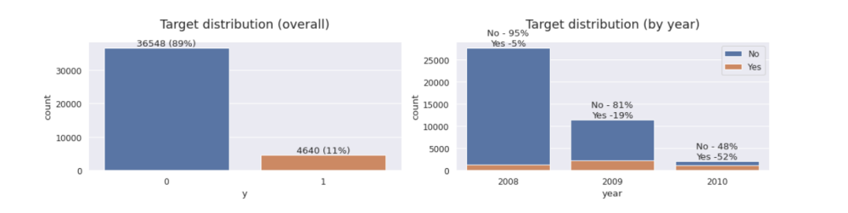
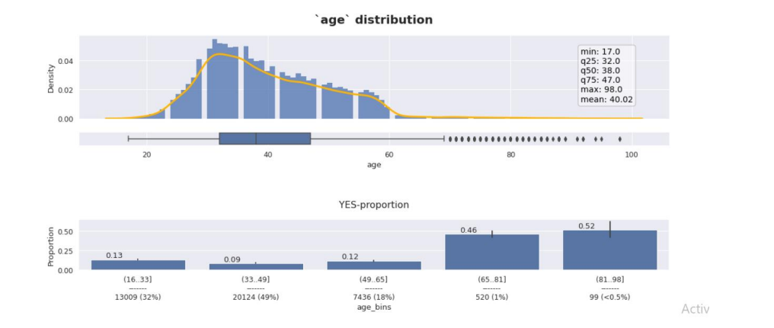
Percentage of term deposit subscription by year
Here, we are adding year ordered by date (from May 2008 to November 2010) as an auxiliary variable to find insights of this as well as socio economic context predictors. Here, in 2010 proportion of yes getting unusually high compared to 2008 , 2009 and this is because of euribor 3 month rate, employment variation rate explained in later.
Here, Age higher than 65 are less percentage targeted and within those targeted clients, bank getting high ‘yes’ proportion than other Age categories.

Slide 8
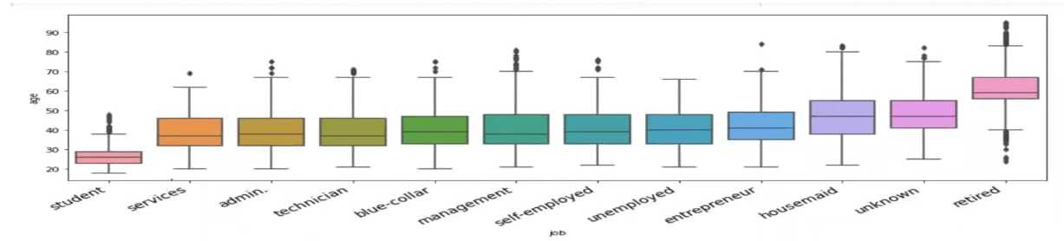
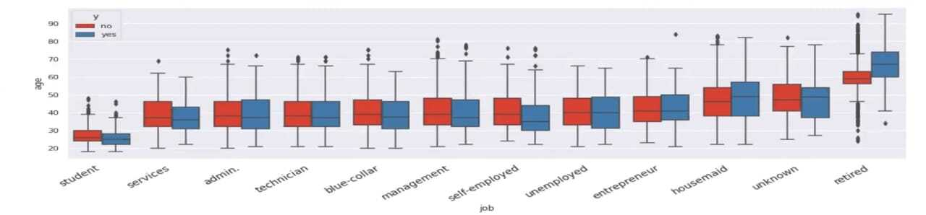
Age distribution of clients by profession

Slide 9
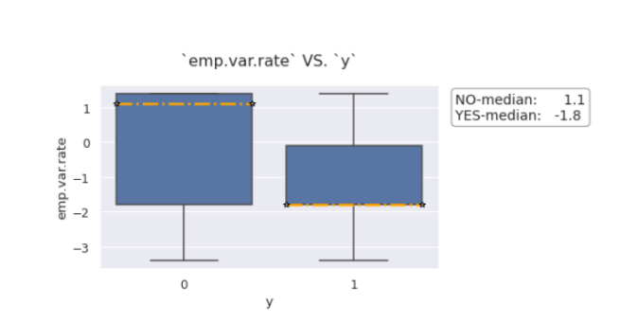
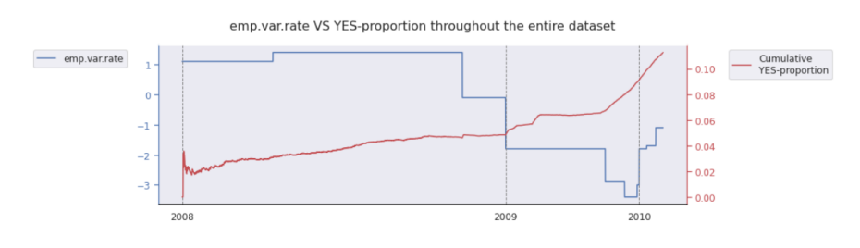
Distribution of employment variation rate by year
Obviously, there is a huge difference between medians, and that's why this feature will be really useful for classification.
As you see, it is a light negative correlation. That means, the higher employment variation rate - the lower YES-proportion we got, and vice versa. And that seems quite reasonable: if the employment rate is highly various, people are not sure about their future and tend to make cautious decisions - so they give YES-answer less frequent. But we should be careful here and recall that correlation is not causation.

Slide 10
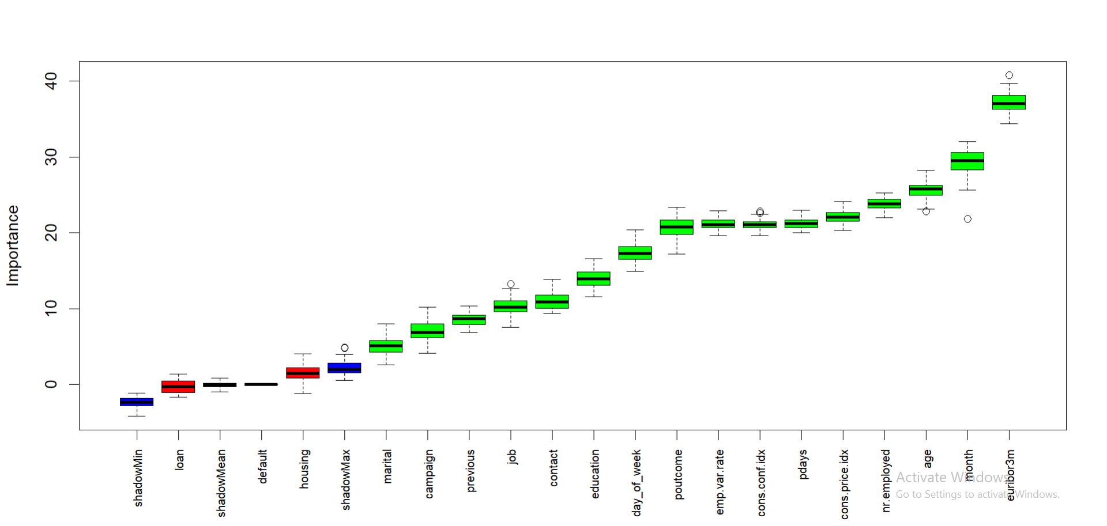
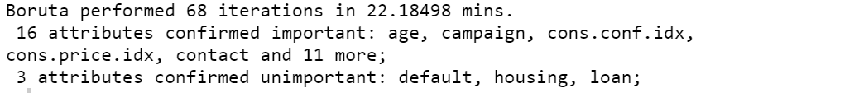
Feature Selection
Boruta is a wrapper approach of feature selection built around a Random Forest Classifier.
This is different and more reasonable to apply here because in PCA , there is needed for Normality assumption and also, it is taking variance into consideration not covariance. Also, same reason for Factor Analysis. Rather, ICA needed only quantitative variables not qualitative.
After performing Boruta, we get the following output:
Red, green boxplots represent Z scores
of rejected and confirmed attributes respectively.
Here, “default” , “housing”, “loan”
are unimportant variables and rest are all important.

Slide 11
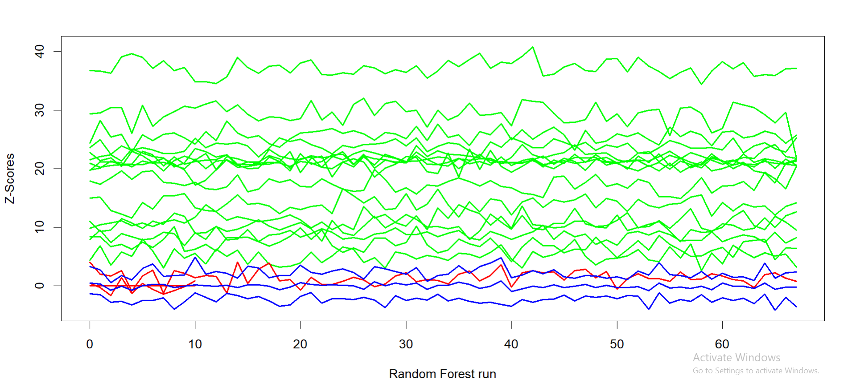
From plotting the runs vs, the feature importance, we can notice that all the attributes of interest are well above the shadow variables defined for the classifier (blue lines).
Hence, given 500 runs, all the attributes are significant.

Slide 12
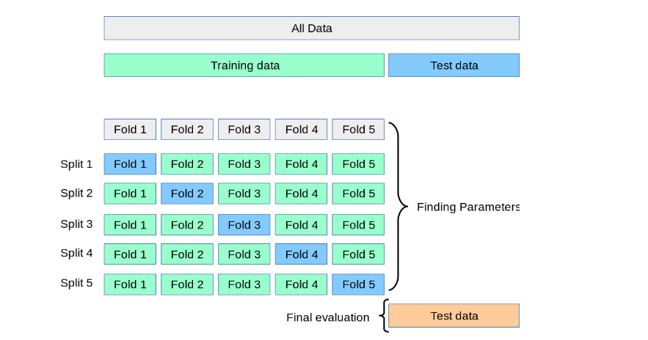
K-Fold Cross Validation:
Cross validation is a procedure for resampling, which is used for evaluation of ML/Statistical models, i.e. it resample the data from a single sample based on a single parameter ‘k’ which defines how many number of groups the sample should be split into.
In the next step, we use ‘k-1’ groups of the ‘k’ groups to train the model and with the remaining 1 group we validate the prediction based on the model built.
Next Step, We repeat the same steps for the k set of combinations of the groups of the sample.
We, have used 10-Fold Cross Validation for our case of validation of the different classifier models.

Slide 13
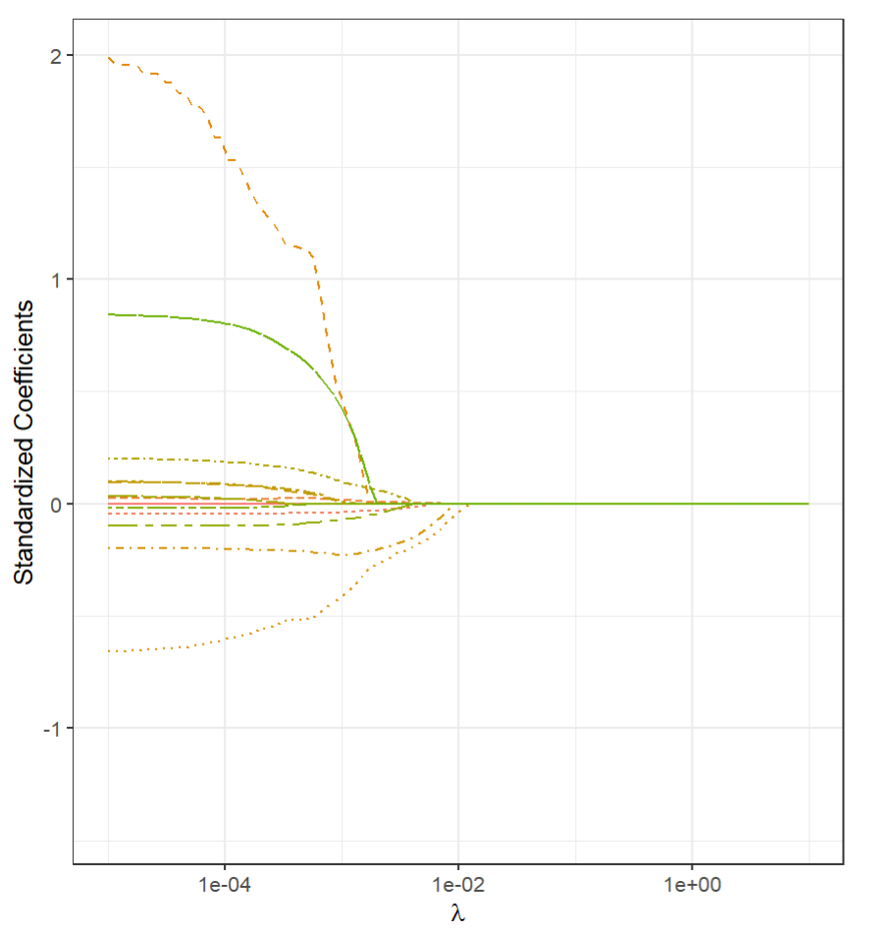
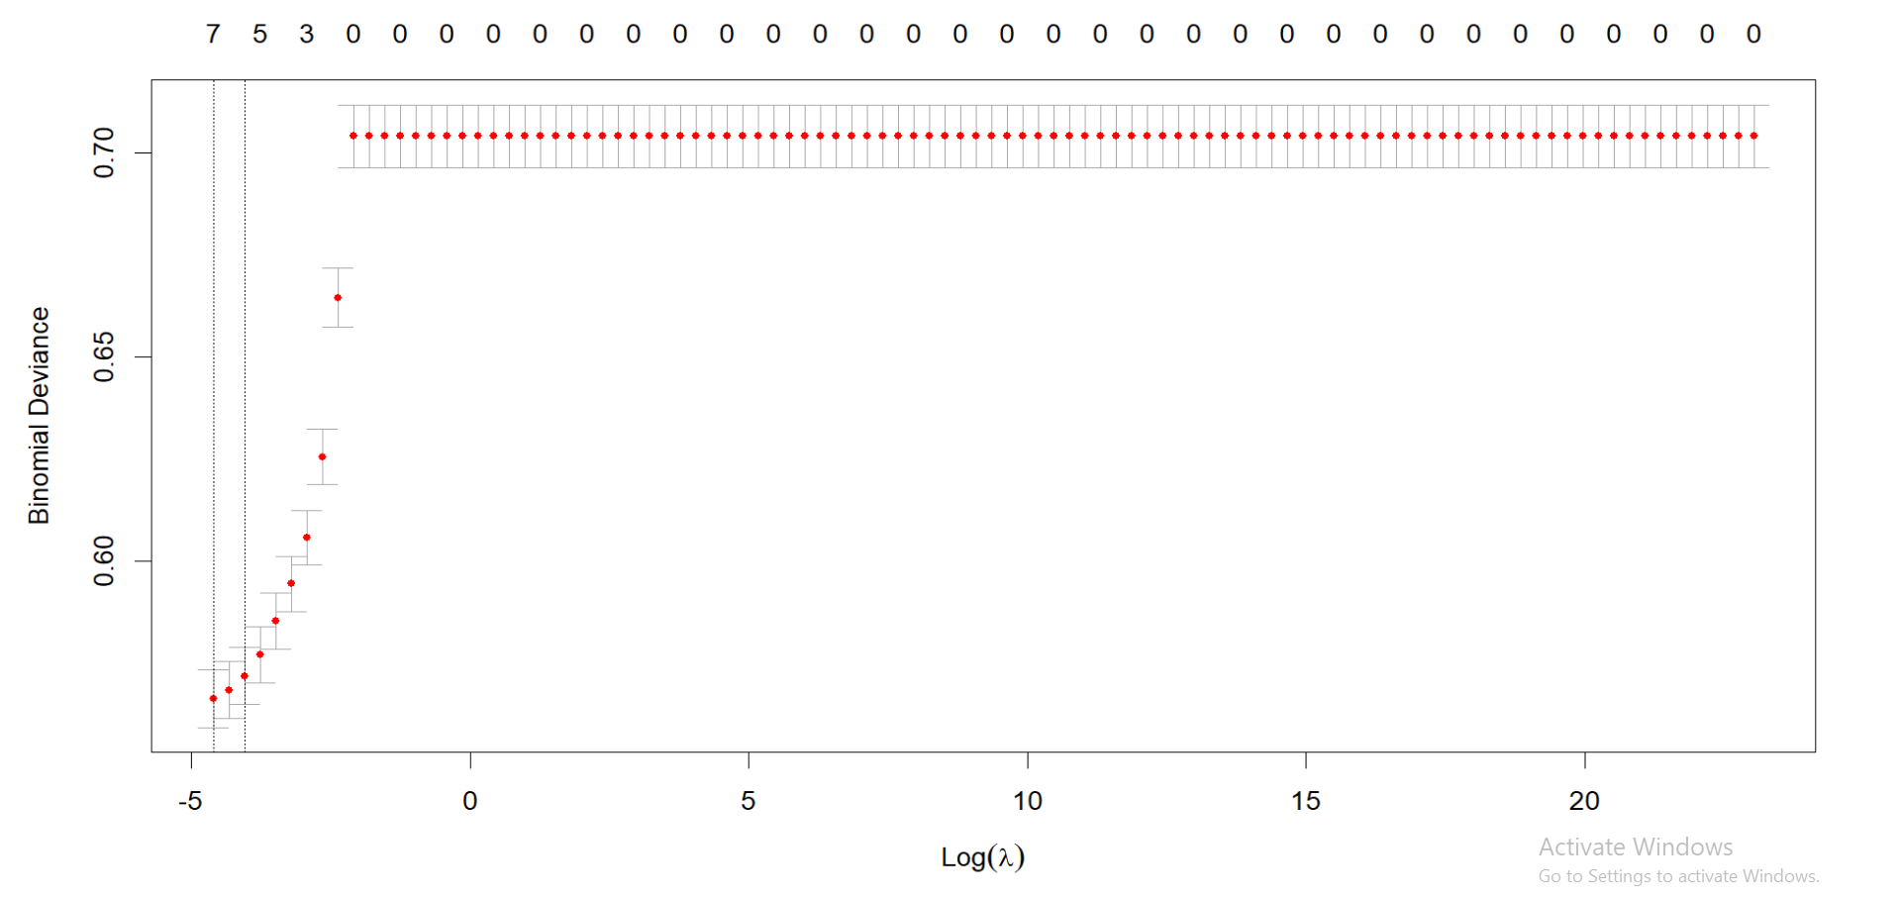
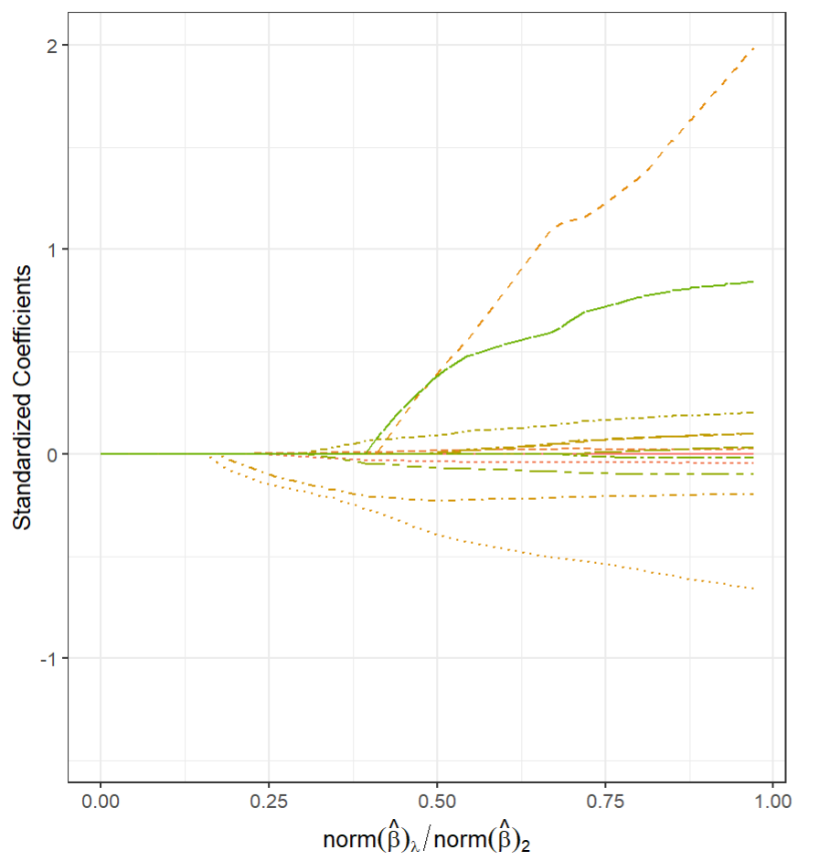
1. Lasso-logistic regression
Binomial deviance is minimum for best λ = 0.01
First dotted line is that λ value for which minimum deviance is
achieved; but for different λ same deviance can be achieved. Second
dotted line is the largest λ for which deviance is within
one standard error of the minimal deviance.

Slide 14
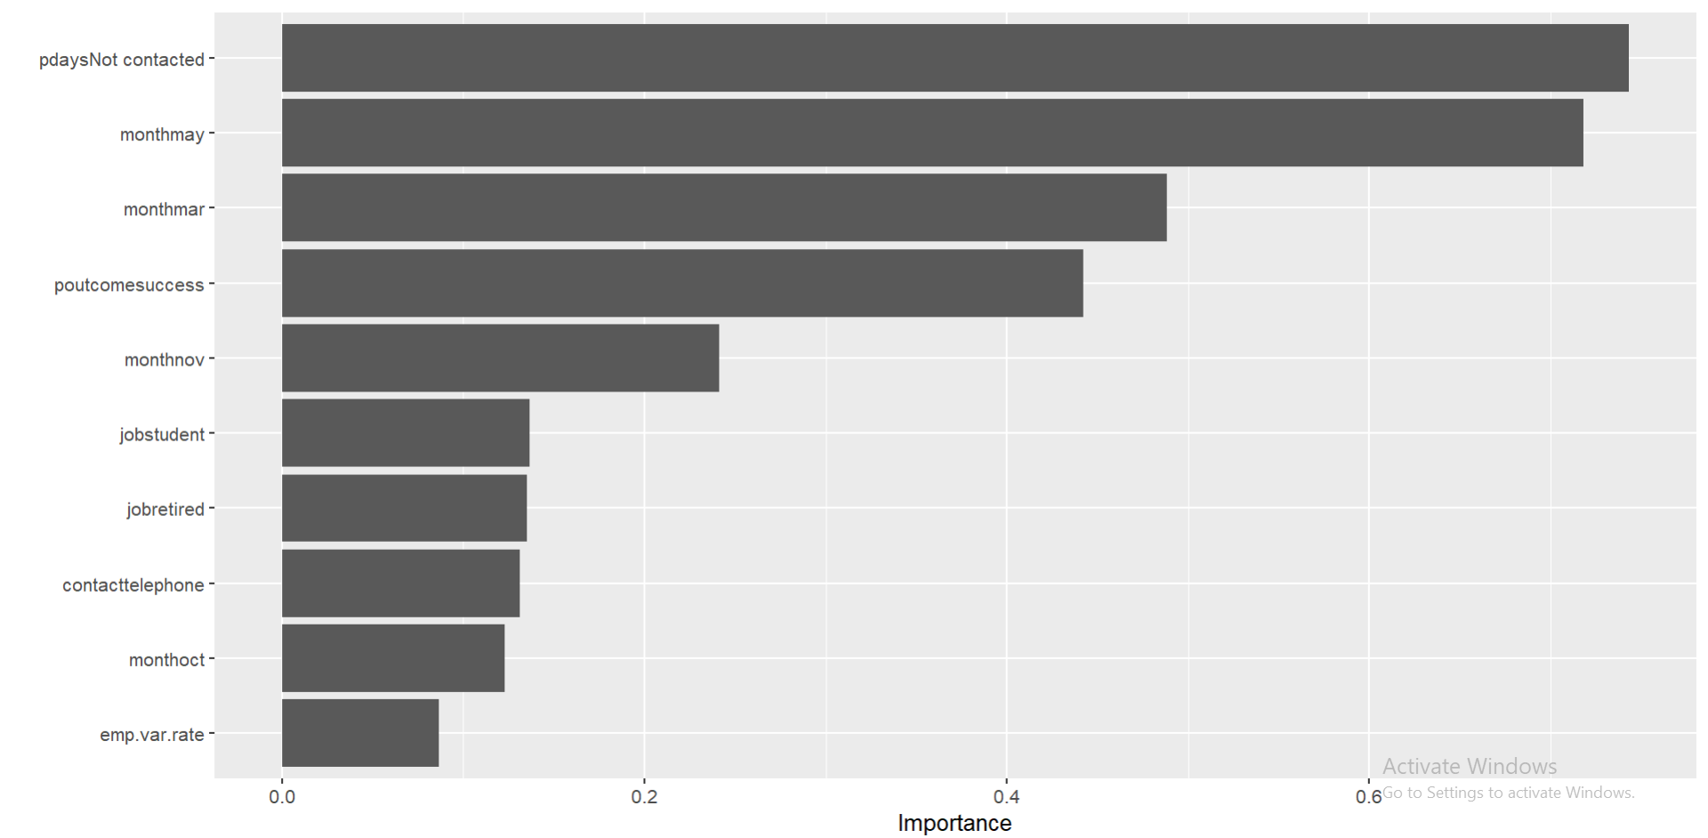
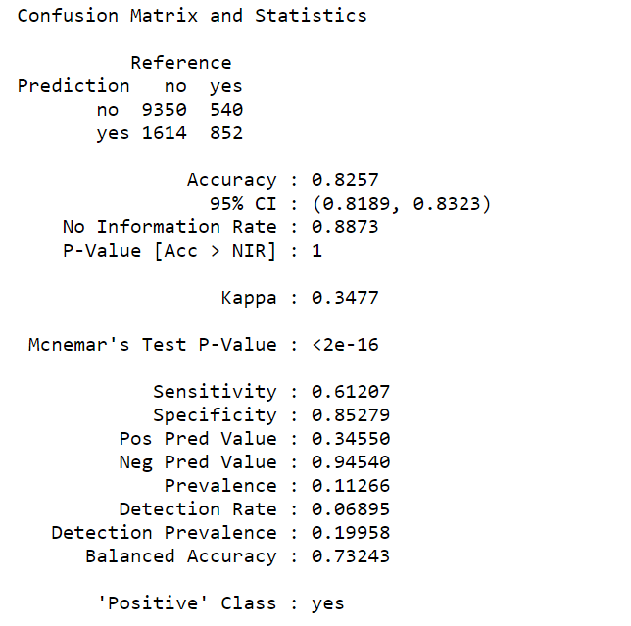
Prediction result
On test dataset
Variable Importance Plot
Here, pdays-Not contacted, month-may is carrying about 70% importance for the model, followed by month-mar and poutcome -success by approx 45%. So, for next campaign,
Target those individuals who have not contacted in previous campaigns.
In month march and may should be targeted to achieve higher success.
Target those individuals who have marked previous campaign as success.
Recall = 61.21% (moderately good)
Precision = 34.55%

Slide 15
Precision-Recall Curve is More Informative than ROC in Imbalanced Data
Accuracy is misleading:
The failure of accuracy as a metric on imbalanced data is well-known. Consider the case of a dataset with the ratio of 1 positive per 100 negatives. On this task, a model that predicts all cases to be negative yields an accuracy of 99%. This model, nevertheless, is a dummy classifier that always predicts the majority class.
AUROC is overly optimistic:
AUROC is threshold-invariant. We do not have to decide what threshold separating positive and negative classes should be in order to calculate the metric. This means even when the two prediction error costs (i.e. false positive and false negative) are unequal, the metric is indifferent to it. However, when the negative class is more prevalent but there is low value in true-negative predictions, the ROC can provide an overly optimistic measurement of a model’s performance. For example, consider the case of a dataset which has 10 positives and 100,000 negatives.
We have 2 models:
Model A: predicts 900 positives, in which 9 of them are true positives
Model B: predicts 90 positives, in which 9 of them are true positives
Obviously, Model B has better performance. Although they both predict the same number of positives, Model B does not output as many false positives. In other words, Model B is more “precise”. However, consider the ROC analysis of the two models, which measures true positive rate (TPR) against false positive rate (FPR):
Model A: TPR = 9/10 = 0.9 and FPR = (900–9)/100,000 = 0.00891
Model B: TPR = 9/10 = 0.9 and FPR = (90–9)/100,000 = 0.00081

Slide 16
TPR is, as expected, exactly the same between both models. On the other hand, since the number of negatives largely dominates that of positives, the difference of FPR between both models (0.00891–0.00081 = 0.0081) is lost in the sense that it can be rounded to almost 0. In other words, a large change in the number of false positives resulted in a tiny change in the FPR and thereby, ROC is unable to reflect the superior performance of Model B in the context that true negatives are not relevant to the problem.
Precision-Recall curve is more informative:
In contrast, the Precision-Recall (PR) curve is specifically tailored for the detection of rare events and is the metric that should be used when the positive class is of more interest than the negative one. Because precision and recall don’t consider true negatives, the PR curve is not affected by the data imbalance. Back to the example above:
Model A: recall = TPR = 0.9 and precision = 9/900 = 0.01
Model B: recall = TPR = 0.9 and precision = 9/90 = 0.1
Clearly, PR analysis is more informative compared to the ROC analysis above.

Slide 17
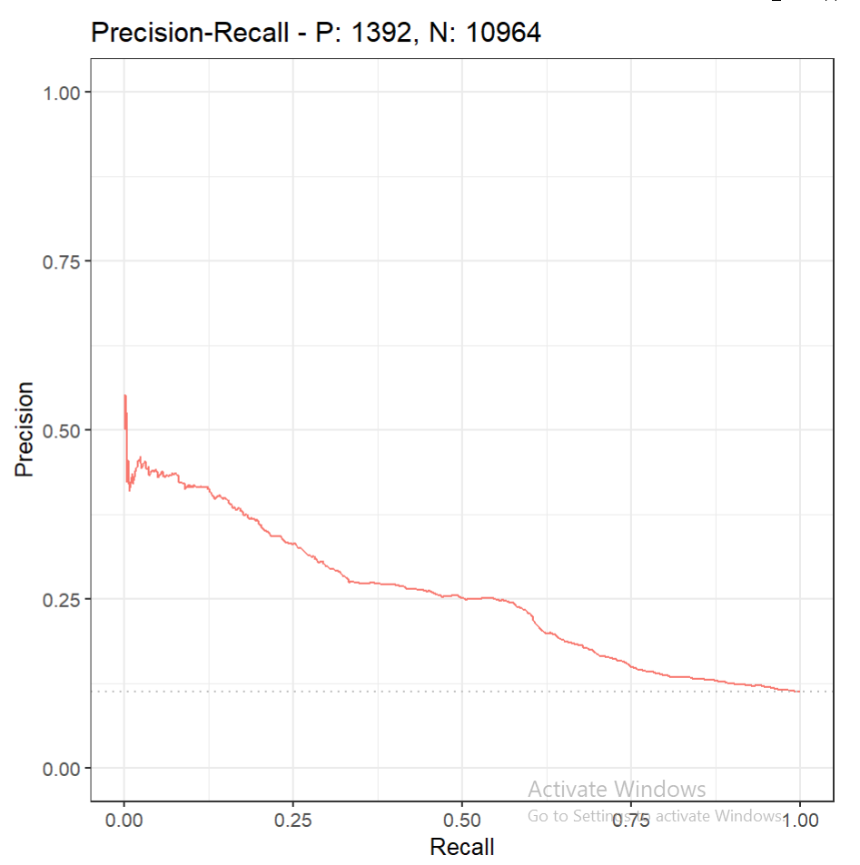
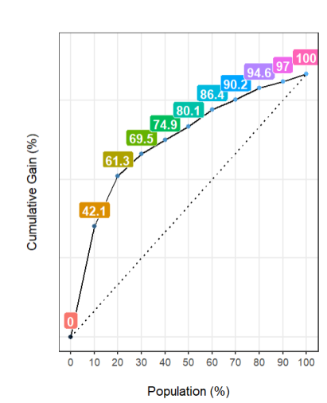
Precision-recall Curve
Cumulative Gain chart
The gray dotted line represents a “baseline” classifier — this classifier would simply predict that all instances belong to the positive class.
AUC = 0.439
75% recall at 12.5% precision, i.e. to get all actual “yes” responses we have to take a high cost of more time and money.
For example, if bank performs top 10%(ordered by score) of most potential customers, then they are going to receive 51.22% positive responses; followed by top 20% giving total 70.20% positive responses.
DALEX : https://rpubs.com/Saikat173/914208

Slide 18
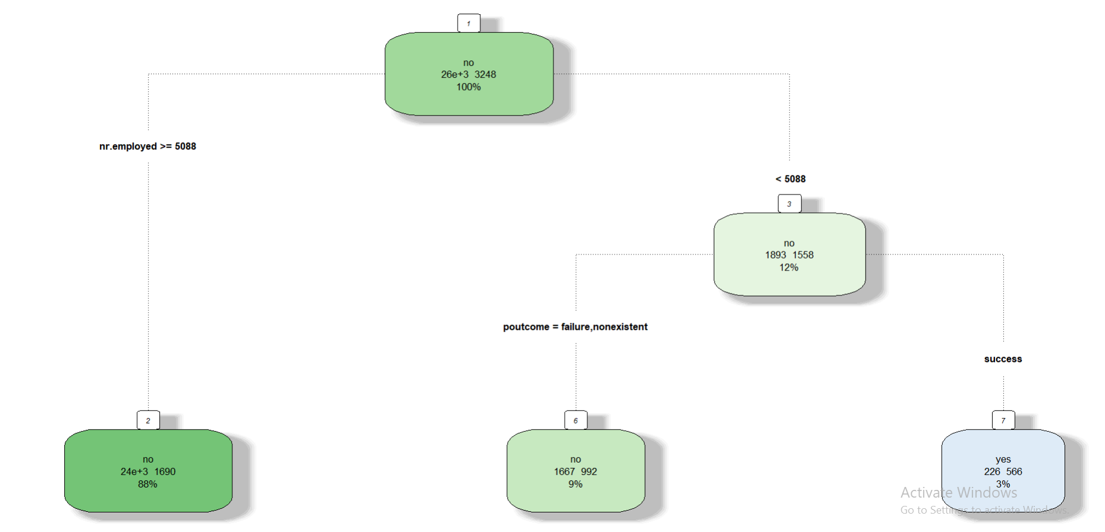
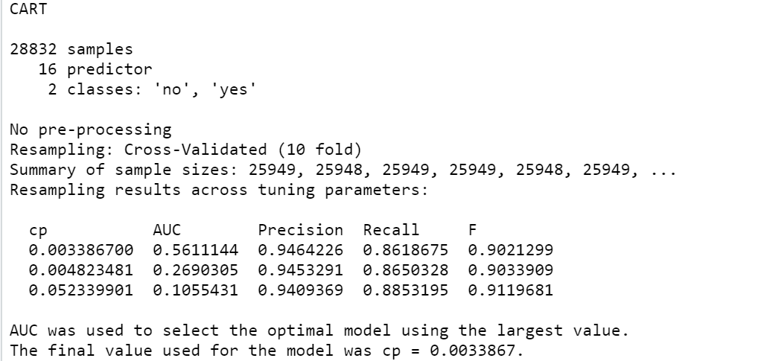
2. Decision Tree Classifier
When nr.employed < 5088 and p-outcome = success is satisfied;
Only 3% people have been targeted and getting success.
So, for next campaign, employees should target this segment when in financial institution, number of employees(quarterly) < 5088 and those customers who said previous campaign was success.(i.e. poutcome = success)

Slide 19
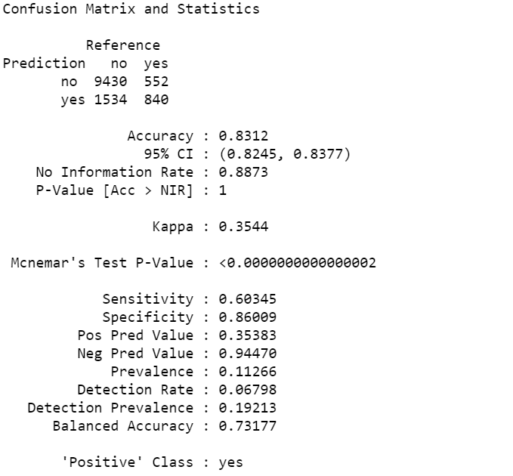
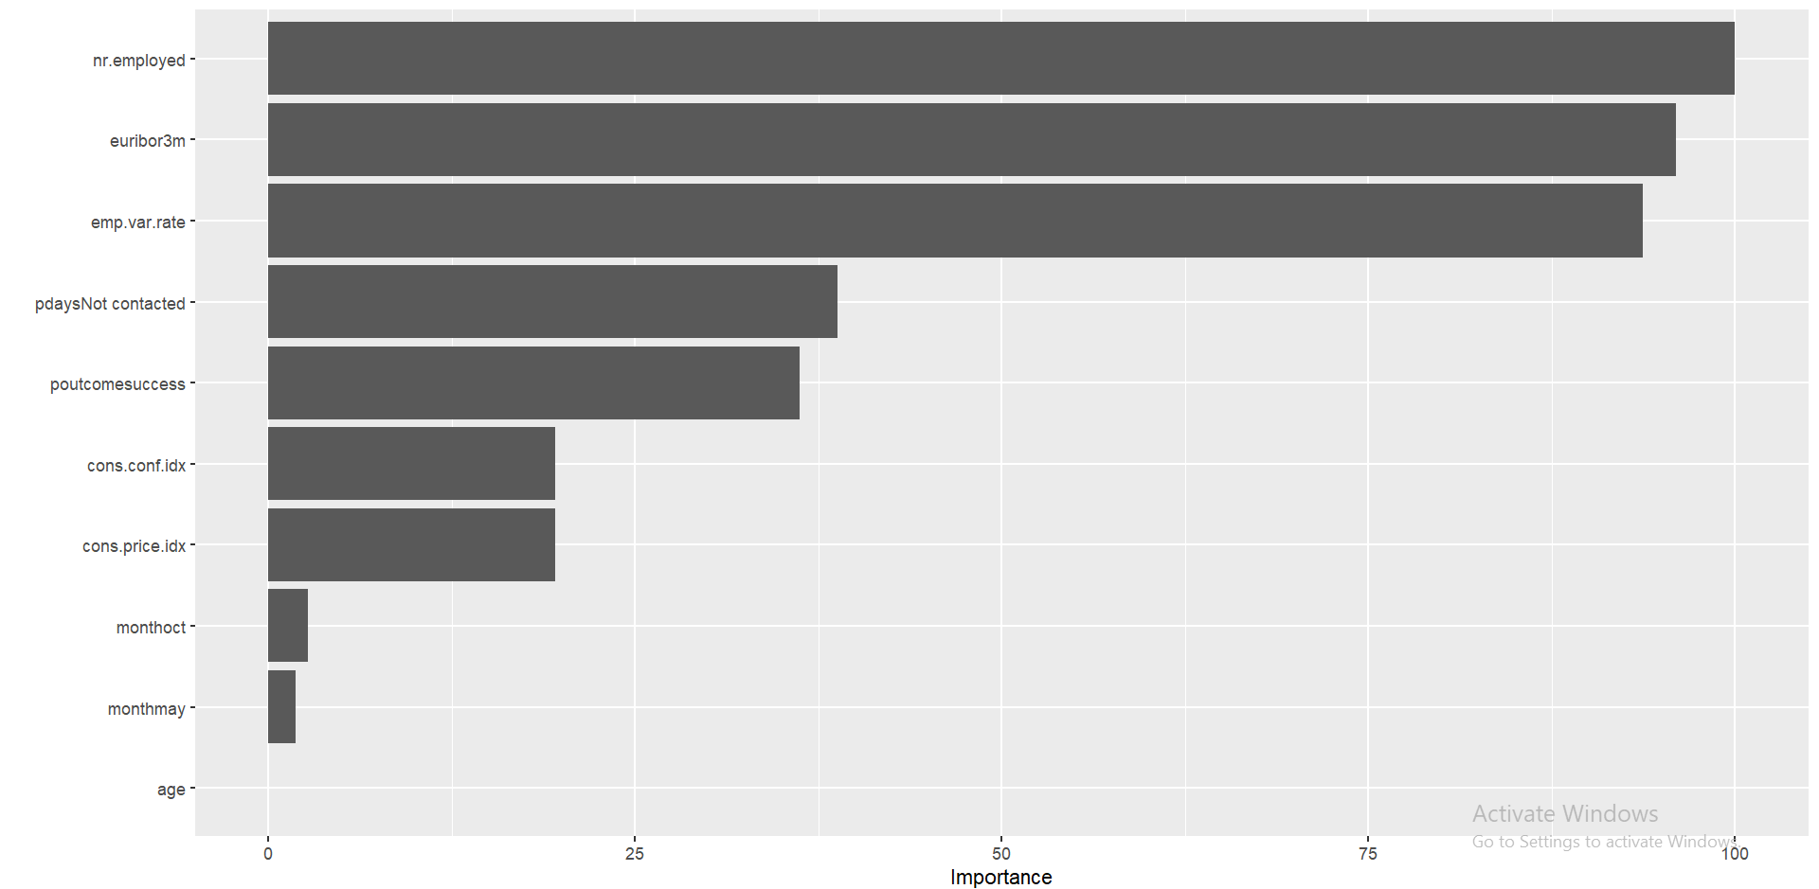
Validation of the model by applying it to the test data:
Variable Importance Plot
Here, number of employees, euribor 3 month rate and employment variation rate are carrying about 90% importance for the model; followed by pdays not contacted and p-outcome success by only 37.50% importance.
Recall = 60.34% (less than lasso-logistic model)
Precision = 35.38%

Slide 20
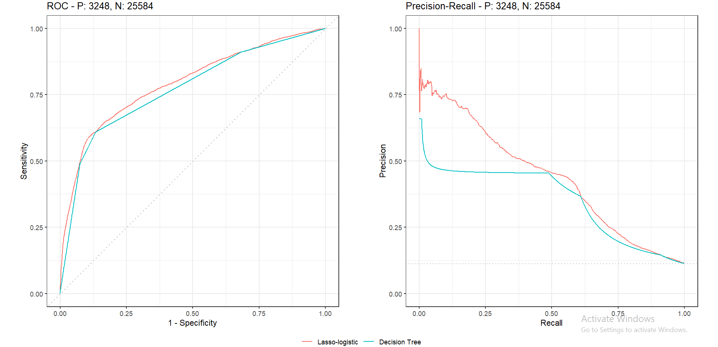
Precision-Recall Curve
Classifier AUC
Lasso-logistic 0.437
Decision tree 0.332
Clearly, for all thresholds lasso-logistic giving better result for recall and precision than decision tree.
Disadvantage:
(i)Decision tree suffers from high variance.
Bootstrap is a general-purpose procedure for reducing the variance of a statistical learning method.

Slide 21
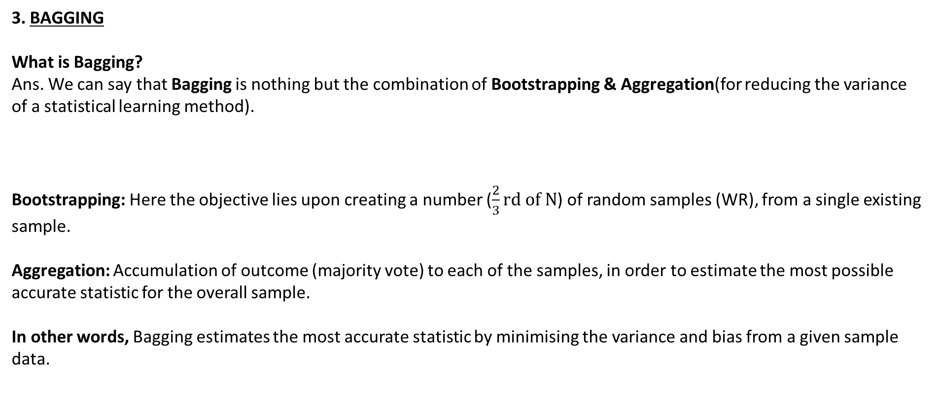
3. BAGGING
What is Bagging?
Ans. We can say that Bagging is nothing but the combination of Bootstrapping & Aggregation(for reducing the variance of a statistical learning method).
Bootstrapping: Here the objective lies upon creating a number ($\frac{2}{3}rd of N$) of random samples (WR), from a single existing sample.
Aggregation: Accumulation of outcome (majority vote) to each of the samples, in order to estimate the most possible accurate statistic for the overall sample.
In other words, Bagging estimates the most accurate statistic by minimising the variance and bias from a given sample data.

Slide 22
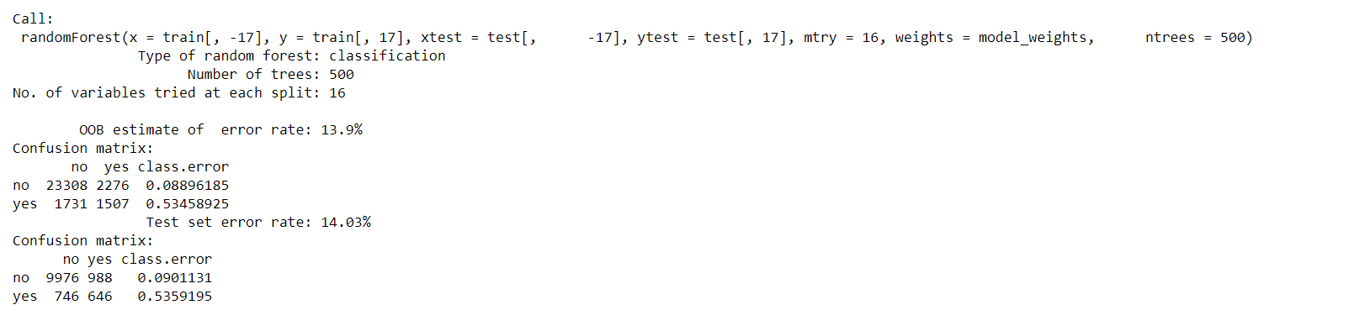
Validation of the model by applying it to the test data:
For Test data,
Recall = 46.40% ( much less than lasso-logistic and decision tree)
Precision = 39.53%
Disadvantage of Bagging:
In bagging, a tree grown every time would consider the very strong predictor at its root node, thereby resulting in trees similar to each other.
The main difference between random forest and bagging is that random forest considers only a subset of predictors at a split. This results in trees with different predictors at top split, thereby resulting in decorrelated trees and more reliable average output. That's why we say random forest is robust to correlated predictors.

Slide 23
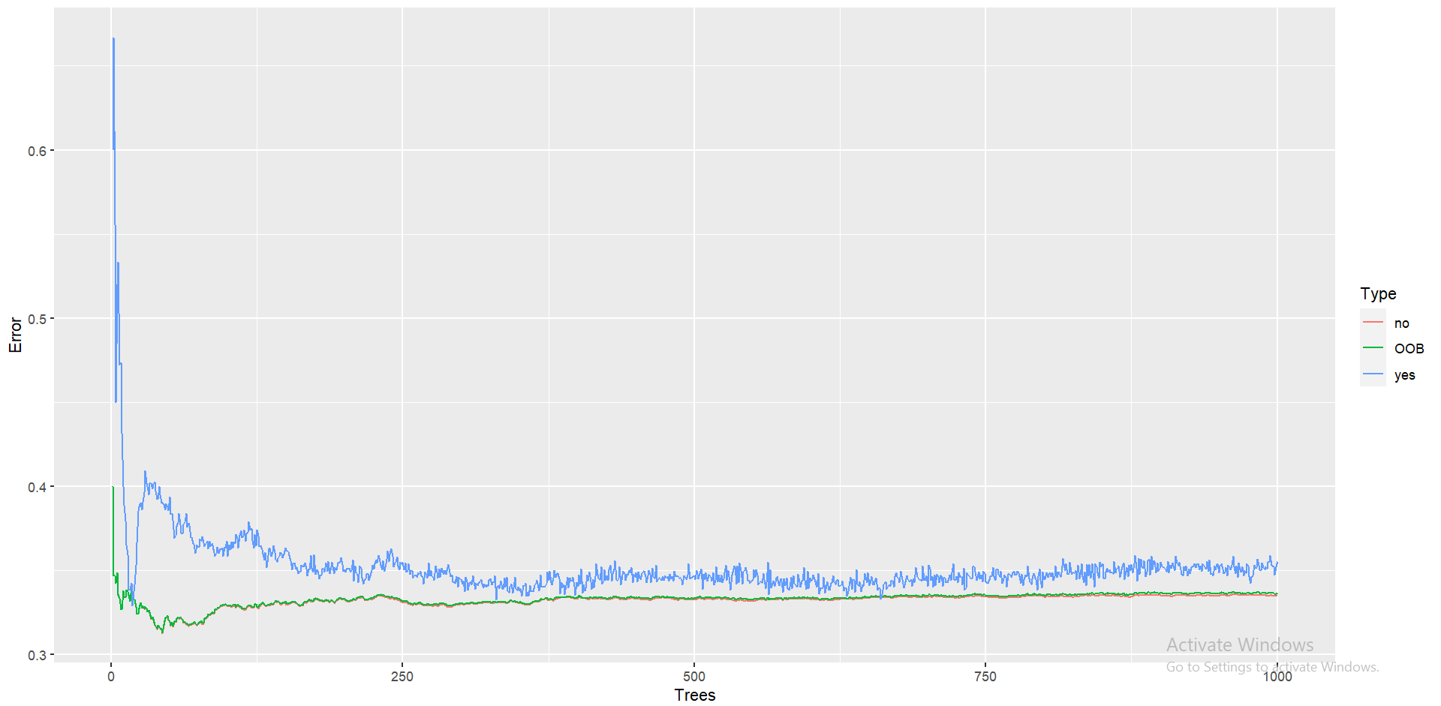
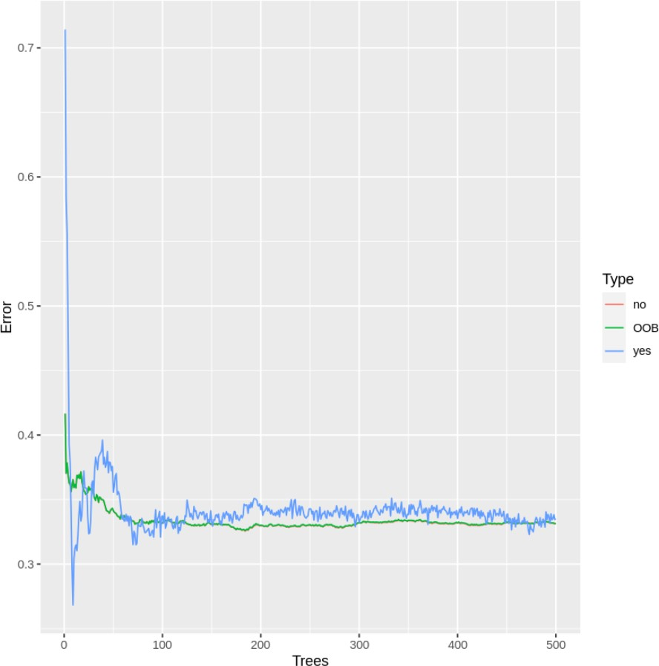
Random Forest Classifier
For number of trees = 1000
For number of tree = 500
By Tuning mtry and min node size we get 1 and 526 respectively.

Slide 24
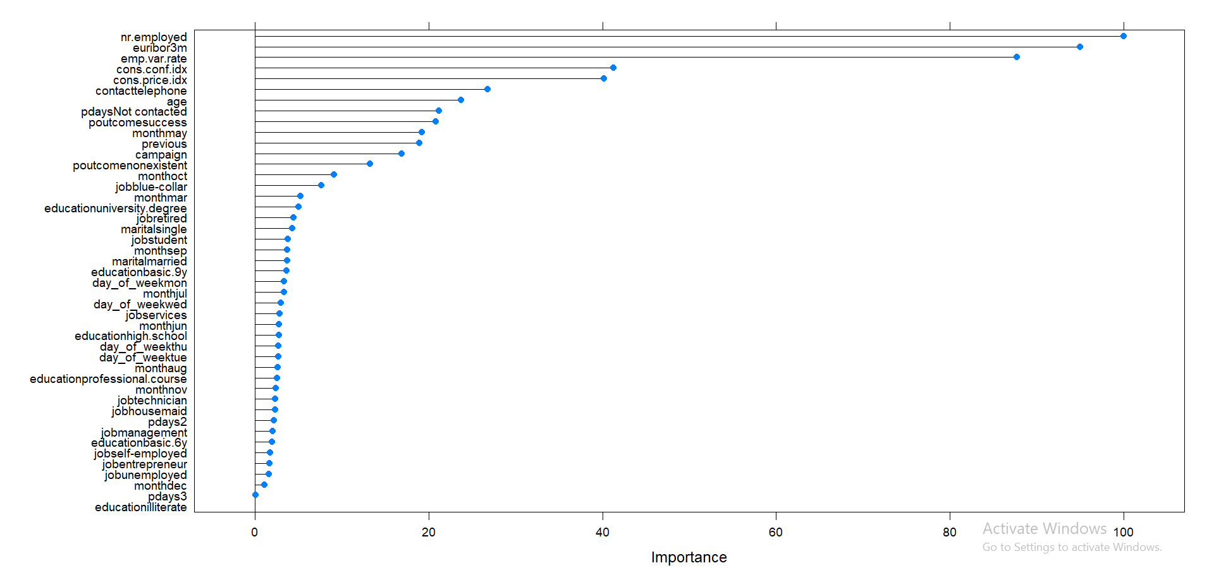
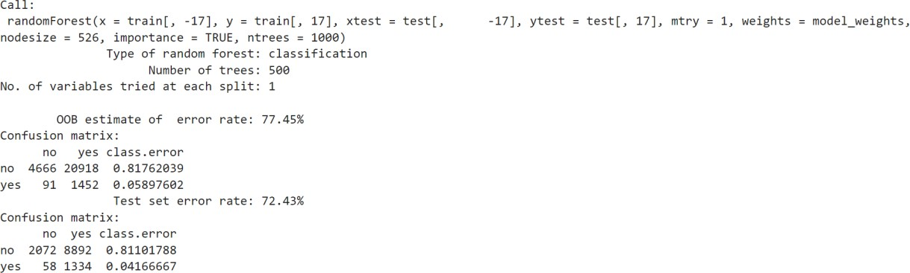
Validation of the model by applying it to the test data:
Variable Importance Plot:

Slide 25
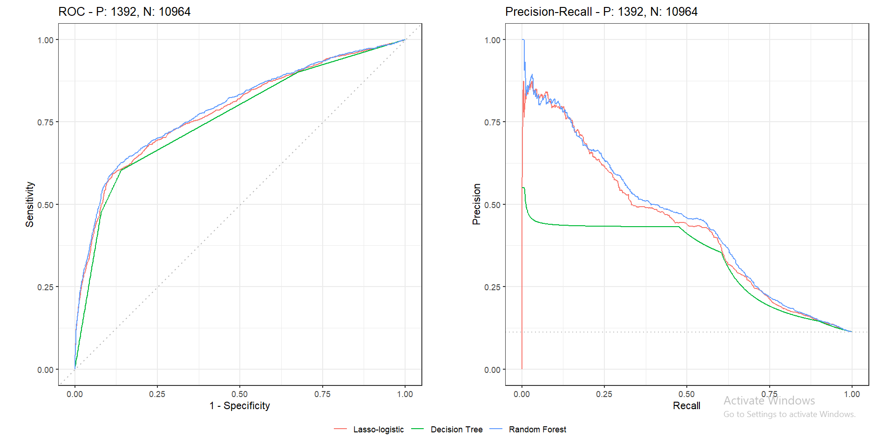
Precision-Recall Curve
 | AUC
Random-Forest | 0.4496
Lasso-logistic | 0.4385
Decision Tree | 0.3324
DALEX : https://rpubs.com/Saikat173/911280

Slide 26
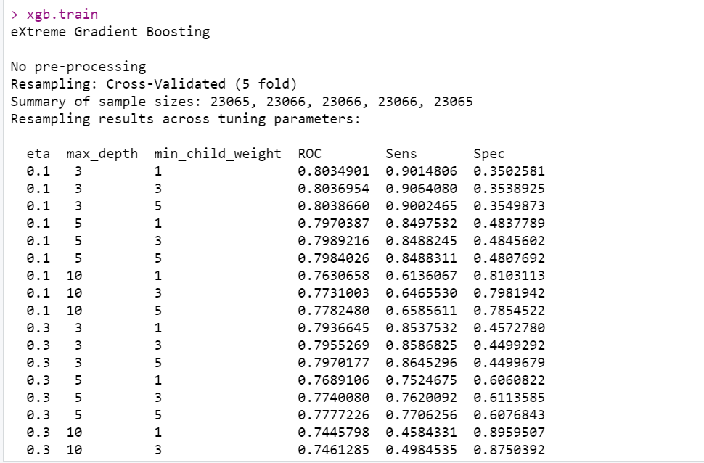
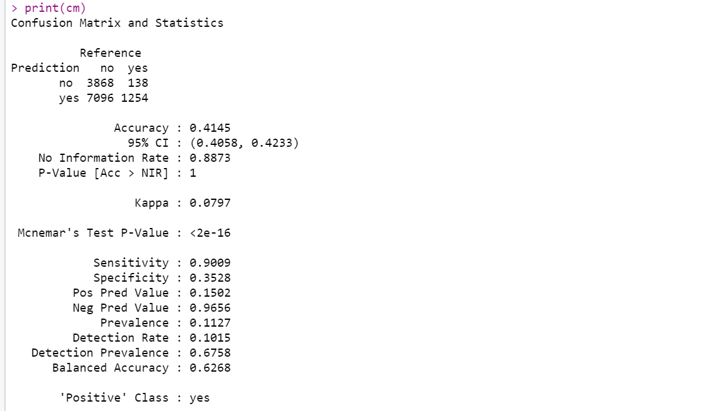
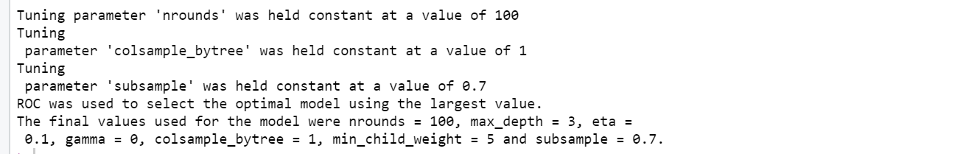
Extreme Gradient Boosting
Validation of the model by applying it to the test data:
Best hyper-parameters
Recall = 90.09% ( smaller than Random-forest)
Precision = 15.02%

Slide 27
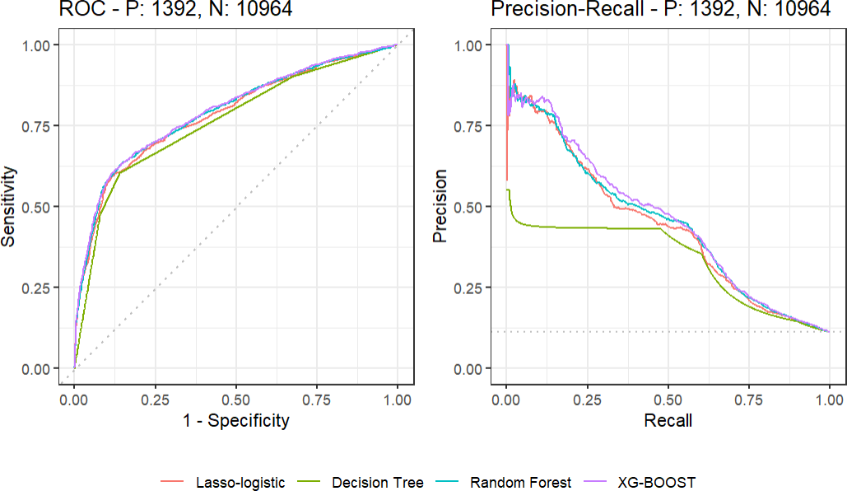
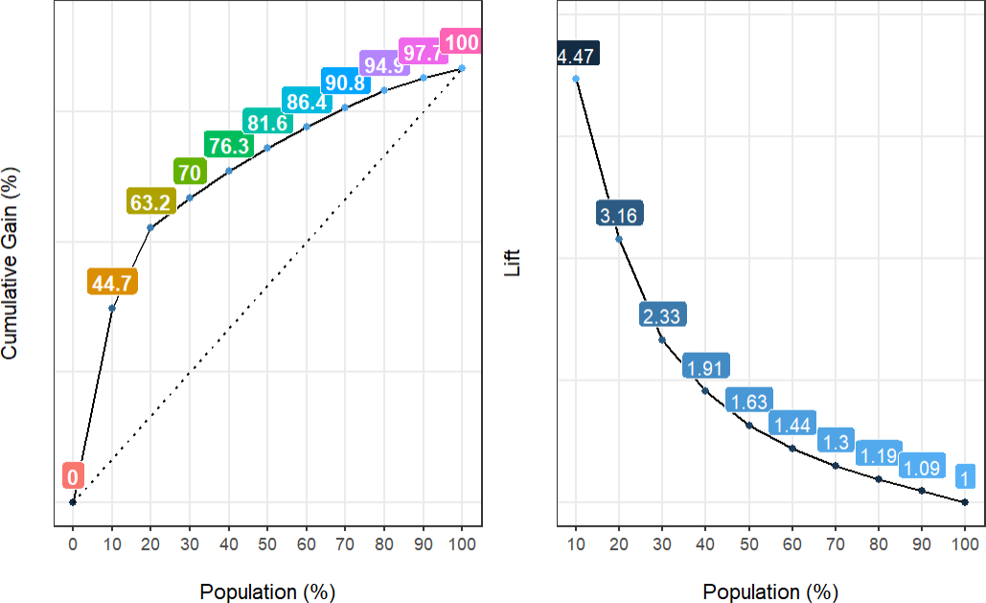
Comparison
Cumulative Gain & Lift Chart
Sample size | Lasso-logistic | Random-Forest | Xg-Boost
10% | 42.1% | 43.3% | 44.7%
20% | 61.3% | 63.2% | 63.2%
30% | 69.5% | 70% | 70%
40% | 74.9% | 76% | 76.3%
50% | 80.1% | 81.4% | 81.6%
60% | 86.4% | 86.6% | 86.4%
70% | 90.2% | 90.8% | 90.8%
80% | 94.6% | 94.8% | 94.9%
90% | 97% | 97.3% | 97.7%
100% | 100% | 100% | 100%
Here, we have used ‘Gain’ as Importance criterion.
 | AUC
Xg-Boost | 0.4605
Random-Forest | 0.4496
Lasso-logistic | 0.4385
Decision Tree | 0.3324

Slide 28
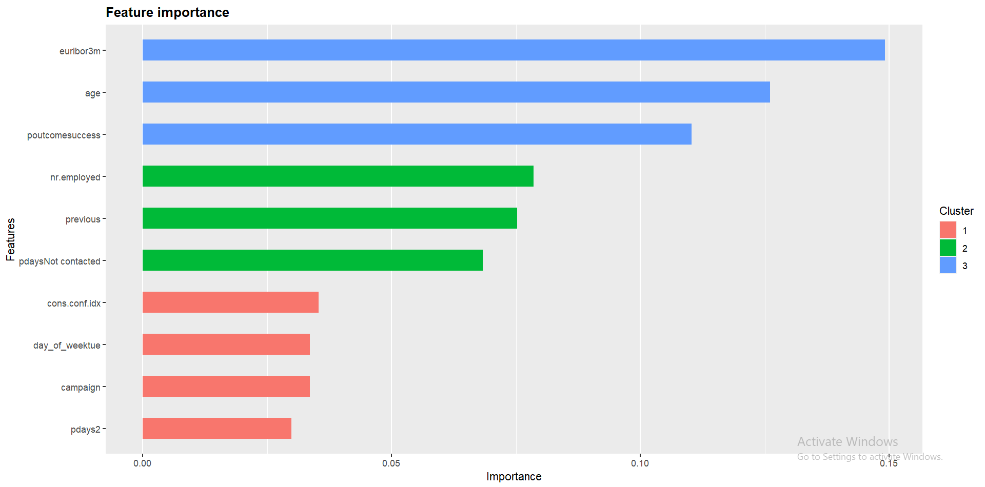
Variable Importance Plot
So, As Xg-Boost is the best model for prediction and explaining the success, the above graph explaining variable’s global importance. Here, Euribor 3 month rate is highest followed by Age and poutcome (if having value as yes) are the top 3 predictors of explaining the prediction by Xg-Boost model. Next, Number of Employed, previous and pdays (if having value as Not Contacted) are the next set of predictor’s almost same percentage of explaining. Least four are consumer confidence index, weekday (having value as Tuesday) , campaign and pdays(having values in the class [9,18) ).
Conclusion
Among all the DM methods, XG-Boost having AUC 0.4605 of PR curve and also from Cumulative gain chart we see that from 10%-50% the chance of getting percentage of yes response is high compared to other DM models by targeting small percentage of clients. Now, from the point of view of Variable Importance, Euribor 3 month rate, Age and Those clients who marked previous campaign as success are highly important predictors for the model. Also, Number of Employees, Number of contacts performed before this campaign, Number of days that passed by after the client was last contacted from a previous campaign are second cluster of important predictors for the model.

